Slide 1
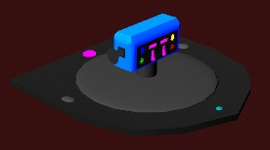
The Force Grip
Ronald Bresett, Rey Acevedo, Dakota Brower, Scott Dolham, Michelle Elmgren
Team Assignment 2
Full Sail University

Slide 2
Abstract
The following presentation will cover the League of Awesome’s One Handed Controller Design Project. In it, each team member shares inspiration from their original design. Then, we discuss what features we took from the original design concepts of individual team members, as well as why we chose those specific features. Images demonstrate the design’s shape, size, and aesthetics. Layouts will map the design to three different game genres. The team built a simple prototype and playtests were conducted to analyze and see how an experienced gamer responded to our design. The team’s Post Mortem summarizes the good and bad experiences of the project along with what we would like to do differently next time.

Slide 3
Introduction
Accessibility is defined as being able to be reached or approached, used or obtained, or appreciated or understood (Accessible, 2015). With this project, we are trying to grow the gaming community by increasing its accessibility with an innovative and friendly controller designed for single-handed use. While there are some options available to handicapped gamers, these designs tend to be clustered and awkward to use. Our goal is to improve the quality of gaming for all gamers and make gaming easier for those with physical disabilities.

Slide 4
Design Purpose
As Designers, we understand what it is to want to use imagination. With video games, our imaginations are stimulated with other worlds that we can explore and experience. The members of the League of Awesome want to make that experience accessible to every individual. We started this project with a focus on accommodating players with physical limitations. Our goal is to bridge the gap between our current gaming communities and disabled players. We strive to give them the freedom and tools to be able to experience the sparks of creativity, to drive their own ambitions, and experience an endless possibility of tales and worlds through video games.

Slide 5
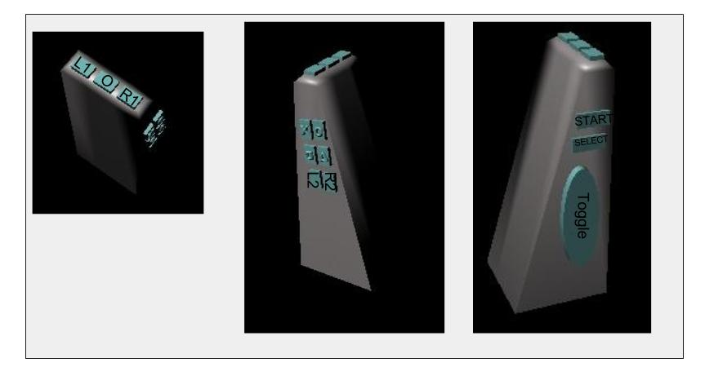
Inspiration: Wedge Shape
Holding my cell phone inspired my controller design idea. I pictured my design to be simple and should easily fit in the hand. For that, the controller would have to be lightweight, a small size, and the controller buttons accessible on all sides. Furthermore, I thought about how a person should be able to hold the controller and interact with the buttons without too much weight shifting within the hand, especially if only one hand is used to hold and support the controller (just as it is possible to do with a cell phone).
The designed controller size was meant to fit easily in the hand and the buttons in accessible places with little hand motion. - Michelle

Slide 6
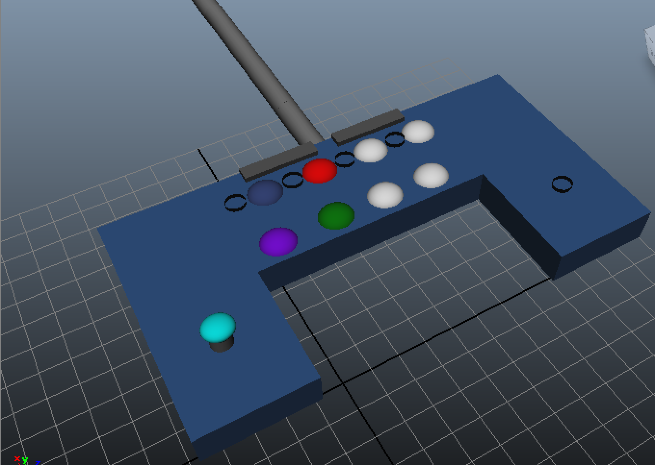
Inspiration: Curved Around Leg
The general theme of the fight stick is what inspired me when creating my controller. The concept of having all buttons shown at once is uncomplicated and straightforward. The layout of the fight stick makes it simple to navigate between all eight buttons with just one hand. Of course there had to be more flexibility considering that holding the controller, while playing with one hand, would be a nuisance. The lap concept caters to those that don’t want to steady it on a table or any hard surface. The player should be able to comfortably play the way they want to, whether it is on their lap or not. When I started to create the design of my controller, I wondered how compact it could be. No one should carry something excessively larger than their hand. The size of it can be compared to that of a SNES controller. The main theme of my design was to make it as symmetrical as possible. It needed to appease both left and right handed people without an advantage over the other. Removing and moving button/analog pieces was a superior option to cater to that theme.
-Rey

Slide 7
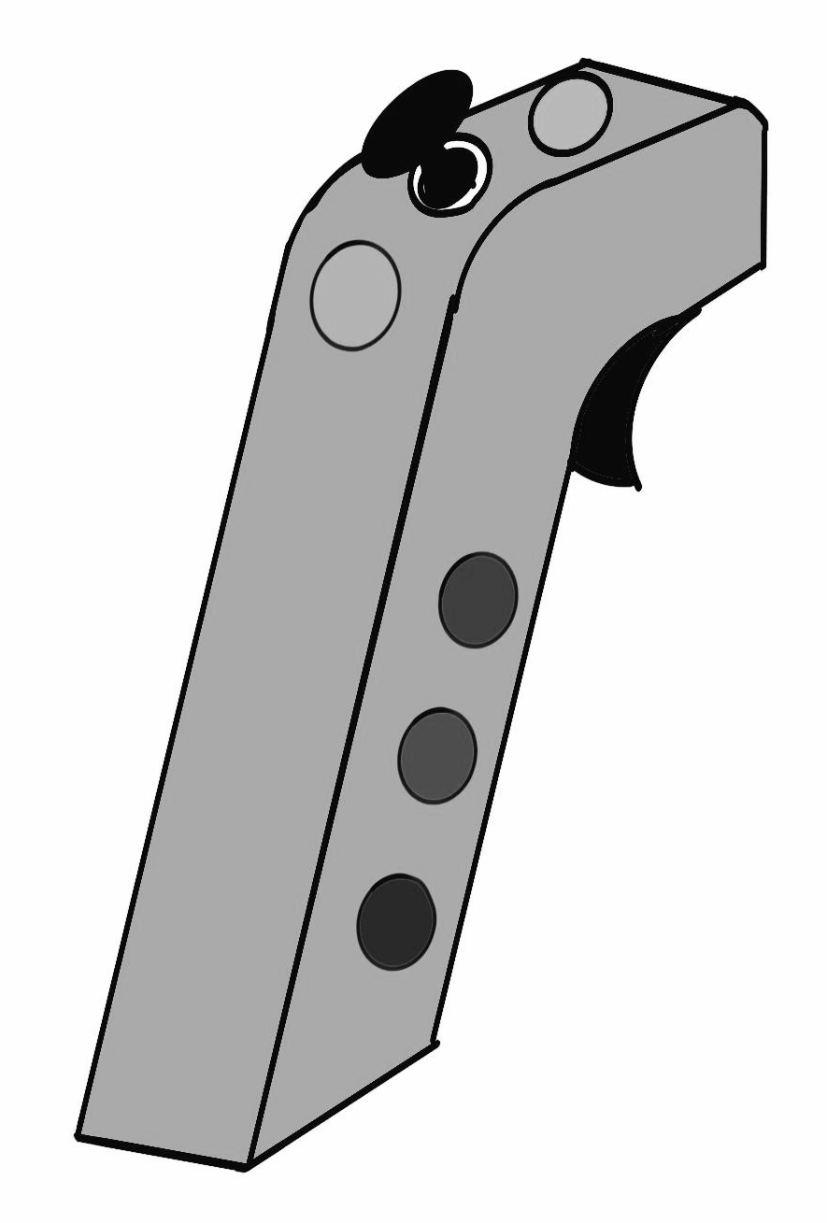
Inspiration: Pistol Grip
When I first began to think about this project, I was reminded of a man I met in the Marine Corps. He lost most of the functionality of his right arm in an IED explosion in Afghanistan. During his recovery, he learned to shoot left handed with the M9 Beretta in a hope to maintain his active duty status. My original design was inspired by this story and the Wii Remote. The M9 Beretta and the Wii Remote are both lightweight, ambidextrous, easy to handle, and adaptable to any situation. I took the familiar and comfortable grip of the M9 and tried to adapt it to a controller design. Then, I looked at how we could get rid of one of the analog sticks that today’s gamers and developers are so used to having. This was achieved by taking the functionality of the Wii Remote and combining it with the other analog stick. After that, I added in the corresponding buttons that today’s gamers are accustomed to in the most comfortable and practical way that I could think of.
-Ron

Slide 8
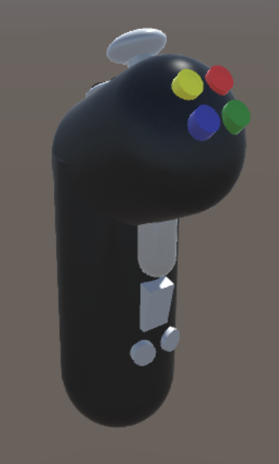
Inspiration: Pistol Grip Controller
The inspiration for the physical portion of my controller came mainly from a combination of the Wiimote & Nunchuck attachment, and the button layout of an XBox 360 controller. Using these two concepts, I figured out how to combine the full accessibility that a normal console controller (such as the XBox 360) has, with the one-handed accessibility that the Wiimote offers on its own. Getting most standard buttons and triggers onto the controller was an interesting design challenge, but the most challenging part was how to integrate the now-standard second analog stick which most games use for camera control. The idea to use a built-in gyroscope/accelerometer combination, which is used in almost every smartphone design, seemed like the obvious choice. The motion sensing technology of the Wii and PlayStation Move is too unpredictable and doesn’t usually translate in a 1:1 ratio, but a gyroscope is far more accurate and requires less processing power to translate to the programmed function of an analog stick. Lastly, due to the need for a wide range of motion, the choice was obvious to give it a wireless bluetooth connection and a rechargeable internal battery.
-Scott

Slide 9
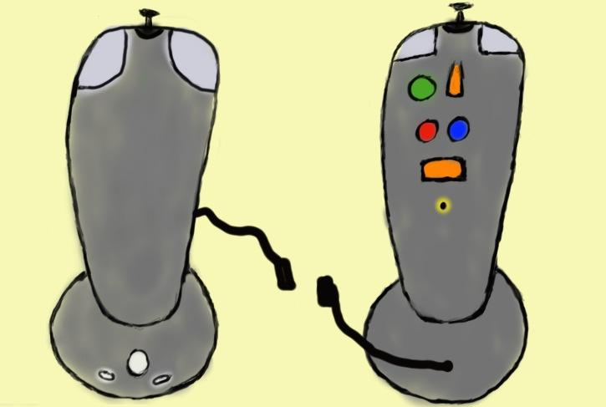
Inspiration: Joystick
I flirted with a lot of different ideas in my mind when trying to come up with my original controller design. The main feeling that I wanted to capture was that I have have when gripping an Xbox 360 controller. It just feels good in my hands, and I can hit any button that I need to with ease. Eliminating one hand would make this very challenging. I strived to simulate that same grip sensation with the ease of access to all of the buttons. When I started sketching this up, it looked quite similar to a flight stick. The main column that the user would be holding doubles as a joystick. To finish fleshing out the design, I began implementing the buttons that are standard between most major gaming consoles. These buttons needed to be modified to make it easier to use fingers, like the pinky. This is where my innovative pinky sensor came from.
-Dakota

Slide 10
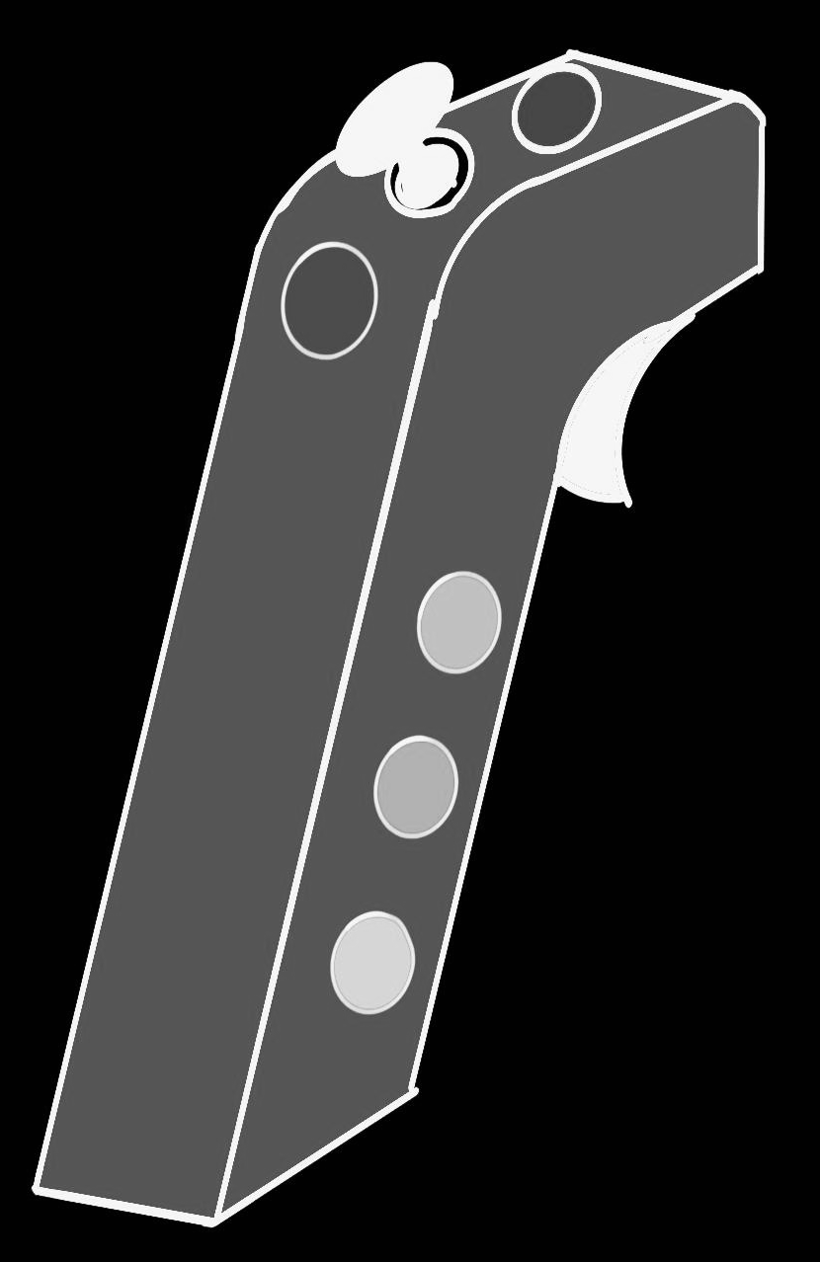
Design Method - Ease of Motion
The primary feature taken from Ron’s design was it’s ease of motion. This feature was taken into account to accommodate the player’s comfort level and increase play times. The main body of the controller is molded in a form that the hand can easily rest on. Instead of the user having to move their arm and hand about to control the device, it will be strapped to the player’s hand and controlled more by their wrist movement rather than the hand. This allows the player the to be more comfortable while playing and increase their ease of access to the controls.

Slide 11
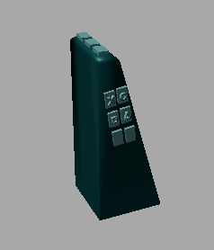
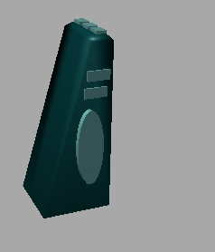
Design Method - Button Configurations
The main feature that stood out from Michelle’s original design was the accessibility of the buttons. In order to incorporate that, the button design on the controller had to be carefully considered. The iPhone only has a few actual pressable buttons, while game controllers conventionally have more buttons to use. The next problem was making the weight distribution as evenly and smooth as possible for player interaction. To solve this, the buttons were clustered closer together on the model instead of spreading them evenly along the length of the piece. Ideally, this allows the player to use the controller in a way that doesn’t cause too much shifting in weight, which potentially would overall
reduce the strain of reaching and extra time it takes to perform an action. That action time reduction could be key to improving player responsiveness to game play stimuli as well.

Slide 12
Design Method - Lap/Table Top & Modular Layout
The table top design that Rey created is to allow the player to comfortably play either on a flat surface (like a table) or to play on their lap. It was added to the final design because it allows the player to freely play the way they’re most comfortable with without being restricted to only one method of playing. The modular aspect of the controller needed to be implemented because it caters to both left and right handed players.

Slide 13
Design Method - Bluetooth/Rechargeable Battery
The design aspects from Scott’s original CAC that were transferred to our final design were the bluetooth connection and rechargeable battery pack. The bluetooth was chosen to allow for greater freedom of position for the player. Without a cord limiting the distance from the console, the player can sit wherever they are most comfortable. The rechargeable battery was chosen due to its efficiency over normal batteries.

Slide 14
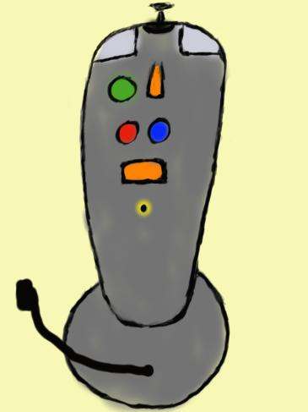
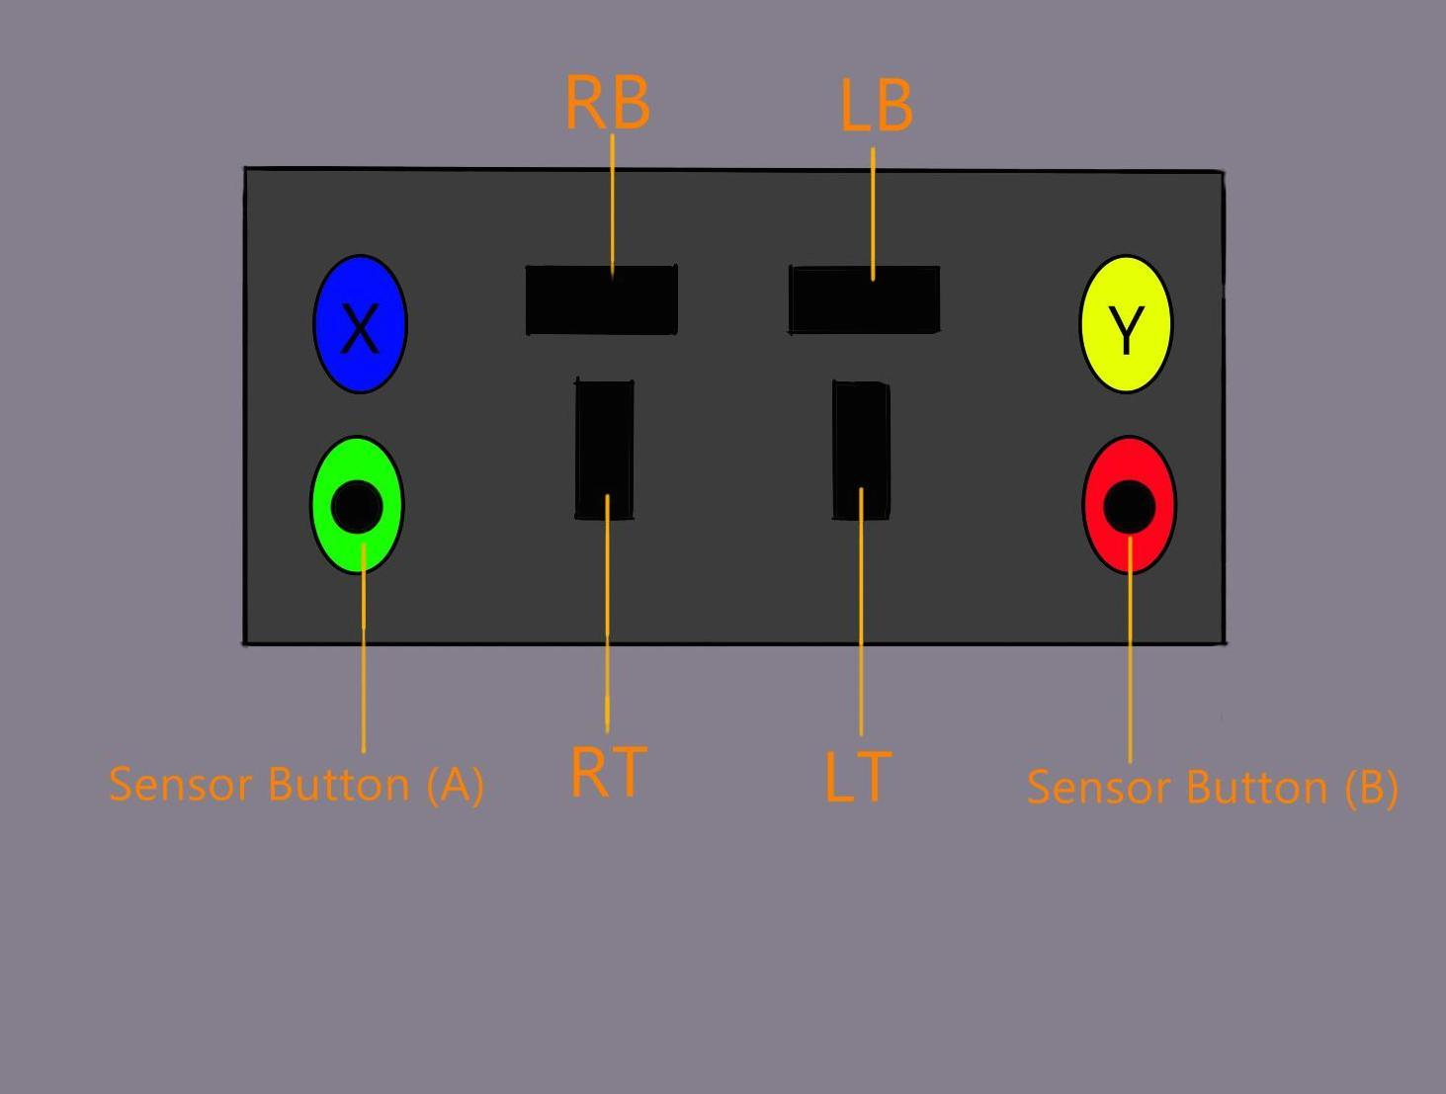
Design Method - Double Joystick/Sensors
Today's gamers are so used to having two analog sticks to work with. To accommodate for this in our design, we took Dakota’s idea of using a Double Joystick system. The main body of the controller is, itself, an analog stick with all of the buttons on it. Attached to it is also the second analog stick.
The other feature that we adopted from Dakota’s original design is his Sensor Button. This is a sensor that takes place of the lower buttons (the A and B buttons) of our design. This makes it easier for the player to activate these buttons without straining their fingers.

Slide 15
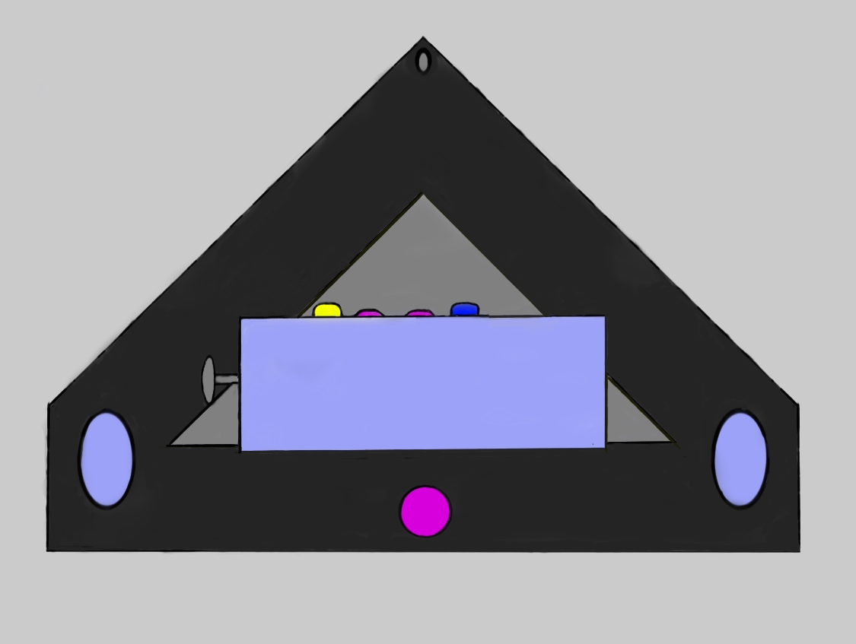
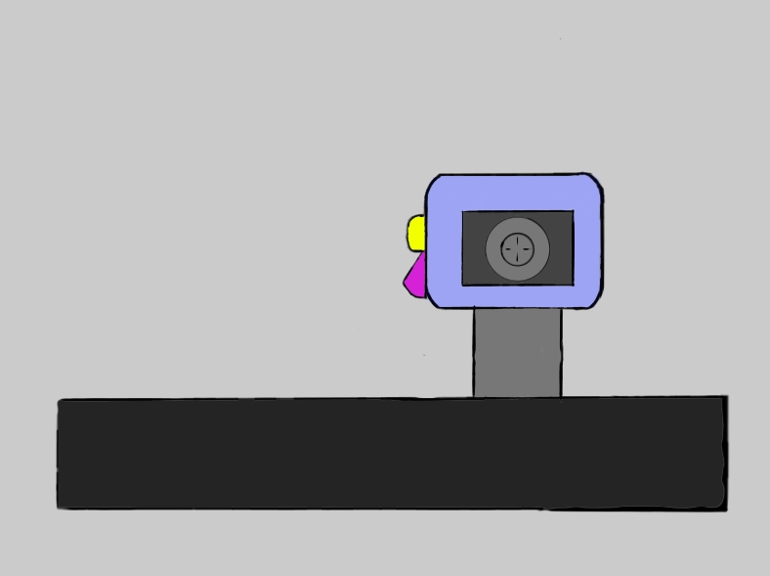
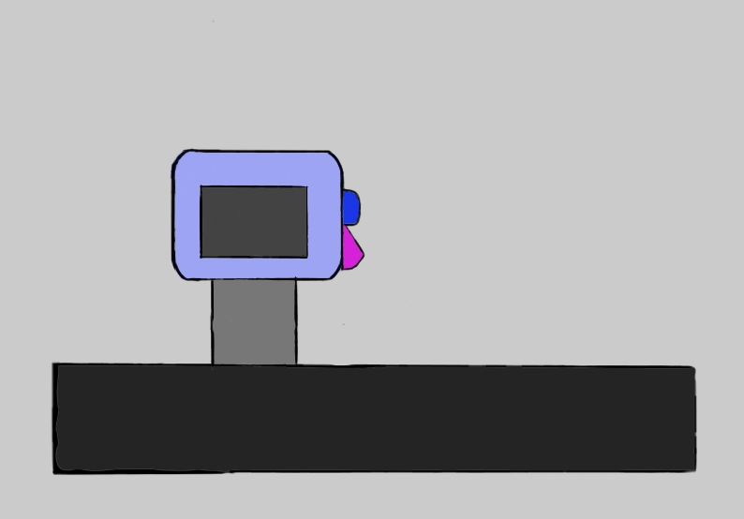
Schematic Diagrams - Concept Art
Left View
Right View
Top-down View

Slide 16
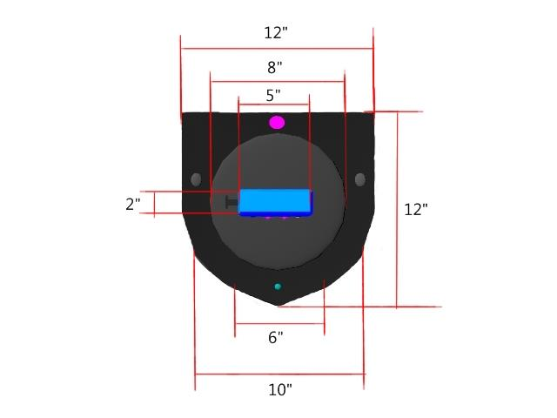
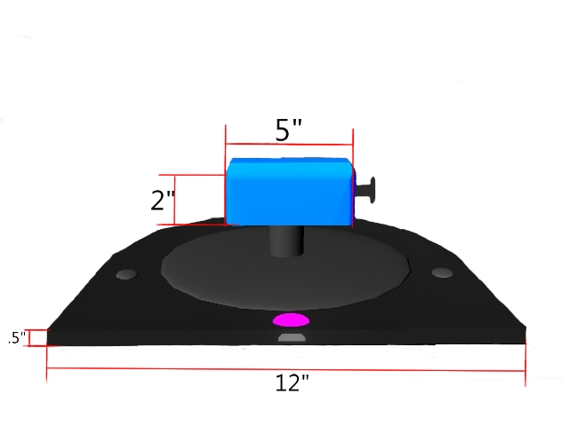
Schematic Diagrams - Dimensions
Top Down View
Back View

Slide 17
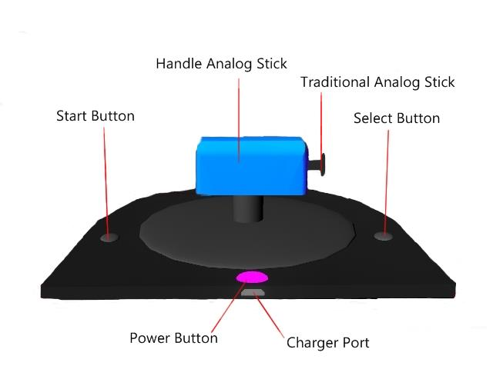
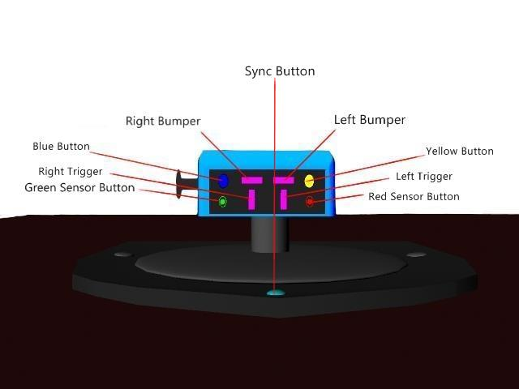
Schematic Diagrams - Explanation of Features
Back View
Front View

Slide 18
State and Defend Design Assumptions - Michelle
Why keep buttons close to each other in the controller layout?
As stated by this patent abstract:
“In recent years, video game system handheld controllers have tended to become increasingly more complicated and more capable. Video game platforms offered by Nintendo and others have provided joysticks, cross-switches or other user-manipulable controls as a means for allowing the user to control game play in a variety of simple and sophisticated ways. Many handheld controllers provide multiple joysticks as well an array of trigger buttons, additional control buttons, memory ports, and other features.” (Nintendo Co, Ltd.)
Therefore, in our design we wanted to offer the player both simplicity and accessibility; however, the goal was also to provide the complex capabilities of controlling their gameplay in different ways. The buttons clustered and spaced together over the handle is meant to provide the player with the ability to interact with the buttons in a way that minimizes actual hand shifting or finger repositioning.

Slide 19
State and Defend Design Assumptions - Scott
Why bluetooth?
Aside from the fact that most game controllers are now wireless, having a wireless controller allows for far more freedom in terms of how the player can actually play the game. By freeing the tether between controller and console, there is no longer a limit of space the player can put between himself and the television, save for the typical 30 or so feet range of the bluetooth signal (Bluetooth, 2015). One final, but vital, reasoning for removing the cord from the controller is that a fit of rage can no longer pose a threat to the console due to the player yanking the controller in frustration (Wagner Jr., 1985).
Why rechargeable battery?
With the bluetooth connection, the controller will require a separate power source in order to be used. For this design, we chose to go with a built-in rechargeable NiMH battery. We chose this option for a few reasons. The first, is that a fully charged NiMH battery can last longer than hundreds of disposable AA batteries. This will ensure that players can play for as long as they wish without worrying about the battery life of the controller during play. NiMH batteries are also easily recycled, making them an environmentally friendly option (Bryant, 2003). The battery is charged via a mini-USB cable which can be plugged into any console with a USB slot or by use of a wall adapter.

Slide 20
State and Defend Design Assumptions - Rey
Why dual surface option design?
Allowing the player to choose how to utilize their controller is one step forward to a tangible freedom. It isn’t just about the experience obtained from the game. It is also about how they interact with the controller to make that experience possible. It gives the player flexibility as to whether they want sit back and relax on their couch (lap option), or simply lean forward and not worry about holding the device (table option). “Using a controller for an extended period of time is especially tiring for the hand which is holding the controller. This hand tends to get sore and/or stiff as it is used to grip the controller during play.” (Wagner Jr., 1985).
Why modular design?
Having the modular design is really a logical step to personal and player success. The controller has to be ambidextrous in order to suffice the needs of both left or right handed players. Being able to switch around buttons and the analog stick to an individual’s preference takes independence to a new level.
“One illustrative non-limiting exemplary aspect of the technology herein provides for positioning video game objects on the screen in response to the position of a handheld controller relative to the display. Rather than moving a joystick or cross-switch, the user simply moves the entire handheld controller.” (Nintendo Co., Ltd.)

Slide 21
State and Defend Design Assumptions - Ron
Why Ease of Motion?
The means in which the player interacts with the device is highly important. If they are straining to manipulate the controls then we, as designers, have failed. We choose to implement a wrist movement control for two reasons. Mainly, as stated by Shafer in Presence: Teleoperators and Virtual Environments:
“If the natural controllers allow for a closer match to these schemas, people will feel that this experience is more real than playing a videogame with a traditional button and joystick controller. Thus, more interactive NUIs result in higher perceived reality” (American Psychological Assoc., Shafer).
Secondly, studies have shown that controllers that are more interactive can be used as a therapy method for extremities. This form of therapy tends to be more engaging and may benefit patients that suffer from hemiparesis and even extremity neuromotor impairments (American Psychological Assoc., Crisco).

Slide 22
State and Defend Design Assumptions - Dakota
Today’s mobile games use haptic technology that generate tactile effects. These effects increase the perception of a greater quality game and add value with an enhanced sense of realism. This, in turn, will create greater user enjoyment, engagement, and thus improved game play (American Psychological Assoc., PR).
Another reason that we steered away from a more traditional design and went with the double joystick feature, is to have more of a natural controller for the player. As McGloin states in Media Psychology, “[Players] who experienced low levels of perceived controller naturalness as a result of using a traditional button and joystick controller experienced a much larger gap in their model matching process”.

Slide 23
Game Summary #1 - Call of Duty: Modern Warfare
CoD: Modern Warfare is a first person shooter played mostly for its online multiplayer.
Our design functions well for first person shooters because we made sure to take into consideration both modern analog stick functions combined with the need to use multiple controls at the same time. Keeping our controls localized allowed us to make sure that the players did not experience any unnecessary exertion or stress. Not to mention, the mobility of the wrist movement works in conjunction with the fast pace that characterize these types of games in this genre.

Slide 24
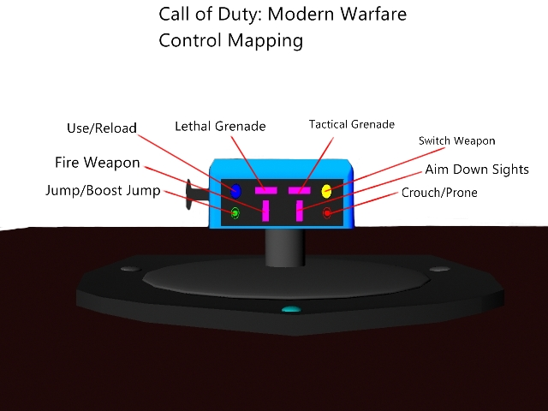
Game Description #1 - Call of Duty: Modern Warfare
The handle analog stick is used to control the camera movement. The traditional analog stick is used to control player movement. Clicking and holding the traditional analog stick will activate the Sprint, Dodge, or Hold Breath as appropriate. Clicking the handle analog stick will activate the Melee or change the Zoom as appropriate. The Start Button would pull up the in game menu. The Select Button will pull up in game stats.

Slide 25
Game Summary # 2 - Never Alone
Never alone is a side-scrolling puzzle game.
Our controller works with sidescrolling puzzles because the features are easily adapted to our unique design. This still allows for the players to use functions that they are familiar with, without a steep learning curve. The simple layout of our controller allows for easy memorization and adaptation.

Slide 26
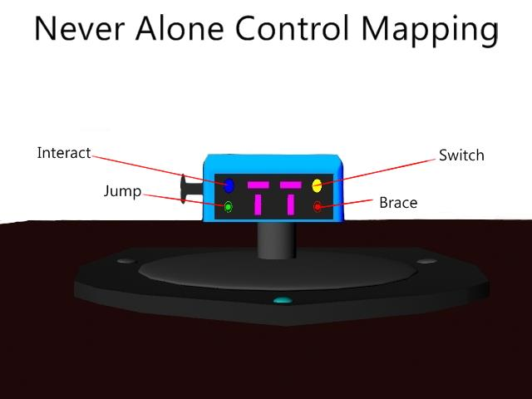
Game Description #2 - Never Alone
The handle analog stick will be used to control the Bola. Pressing the handle will release it. The traditional analog stick will be used for player movement. The Start button will access the in game menu, while the Select button will be used for Insight.

Slide 27
Game Summary # 3 - Halo Wars
Halo Wars is an action packed real time strategy game.
The game requires players to be able to pan around the map while commanding troops. Our controller performed well while manipulating these actions because of the ability to access all of the buttons with very little hand repositioning. This is very important in a game like this because there is an extreme focus on multitasking.

Slide 28
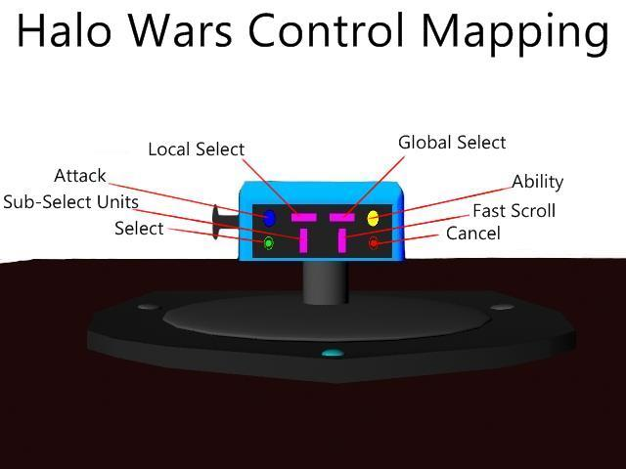
Game Description #3 - Halo Wars
The handle analog stick will control the camera movement. Pressing and moving the handle at the same time will rotate the camera. The traditional analog stick will activate different mechanics within the game. The Up direction will activate the players special power or hero. Left will cycle through the bases. Down will cycle through the player’s armies. Right will bring up the player’s alerts.

Slide 29
Prototype
The following steps were taken to resemble the feeling and layout of the designed controller. Foam was cut down into a rounded square shape and blue paper wrapped around it to closely match the aesthetic design. Creatology Wiggle Eyes were painted to represent the yellow, blue, and grey buttons that the player would be pushing. Glitter textured scrapbook paper was used as sensor buttons on the controller prototype, so that the player could easily identify when their hand was touching the sensor (also to simulate that the sensor would potentially give a vibration response to the player when touched). Pipe cleaner was used for the Right and Left Bumpers, Right and Left Triggers, analog stick, and the base with which the Handle moves along different axis. Ribbon was used to simulate the hand strap to secure the hand close to the controller. A tie was used for the removable leg strap. Cardboard was used for the base.

Slide 30
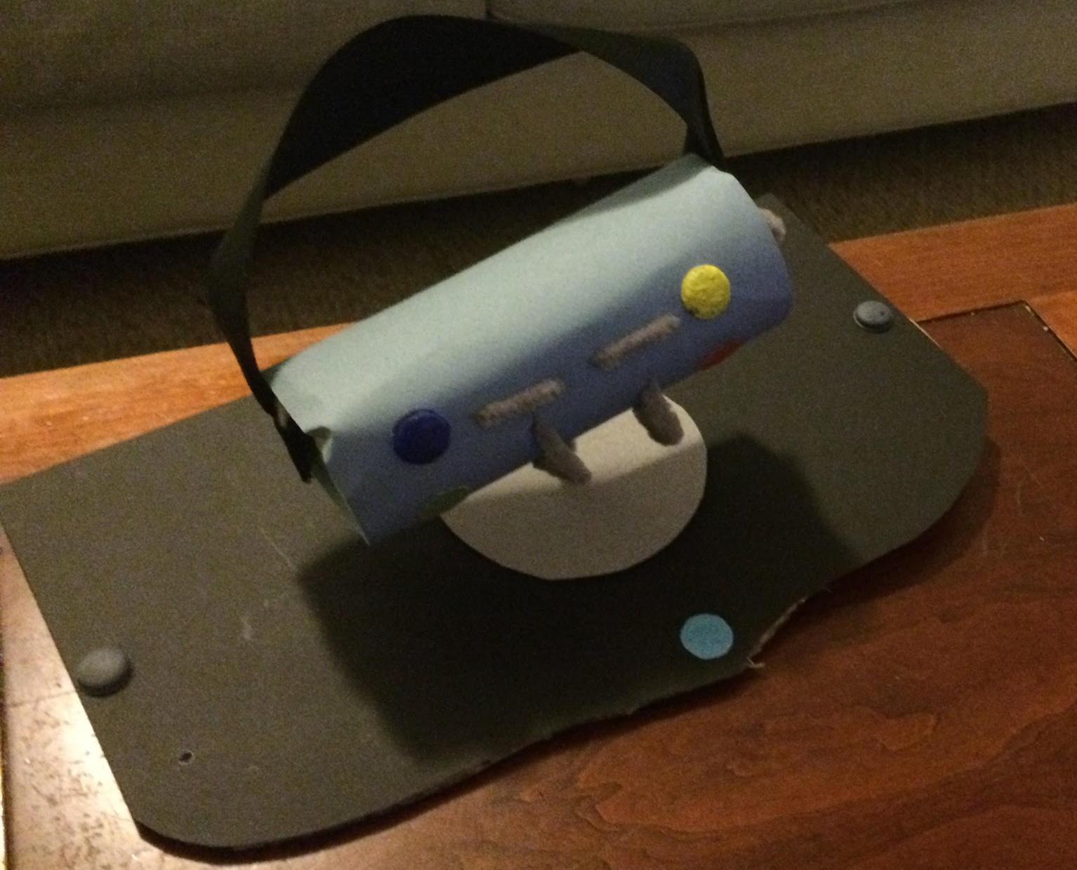
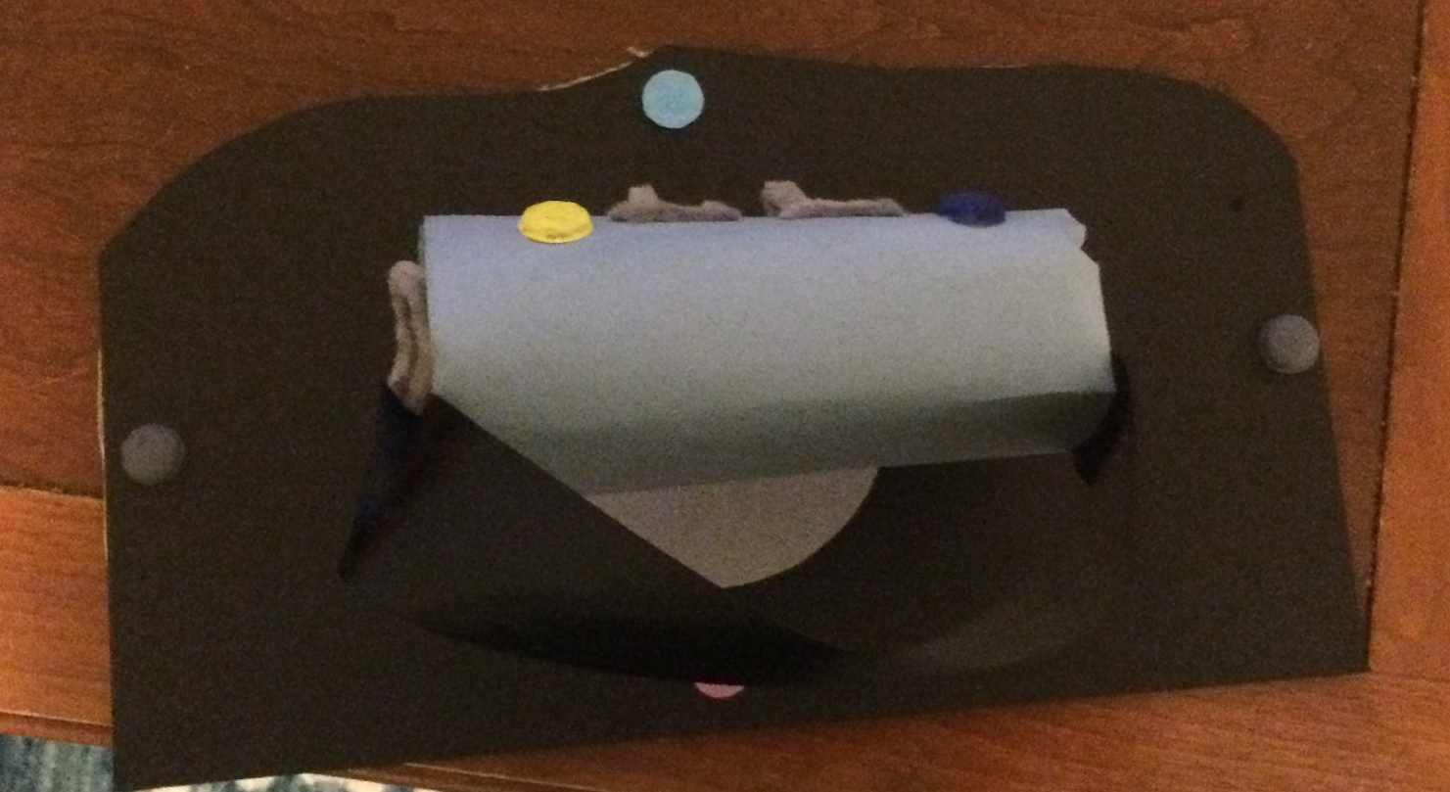
Prototype (Cont.)

Slide 31
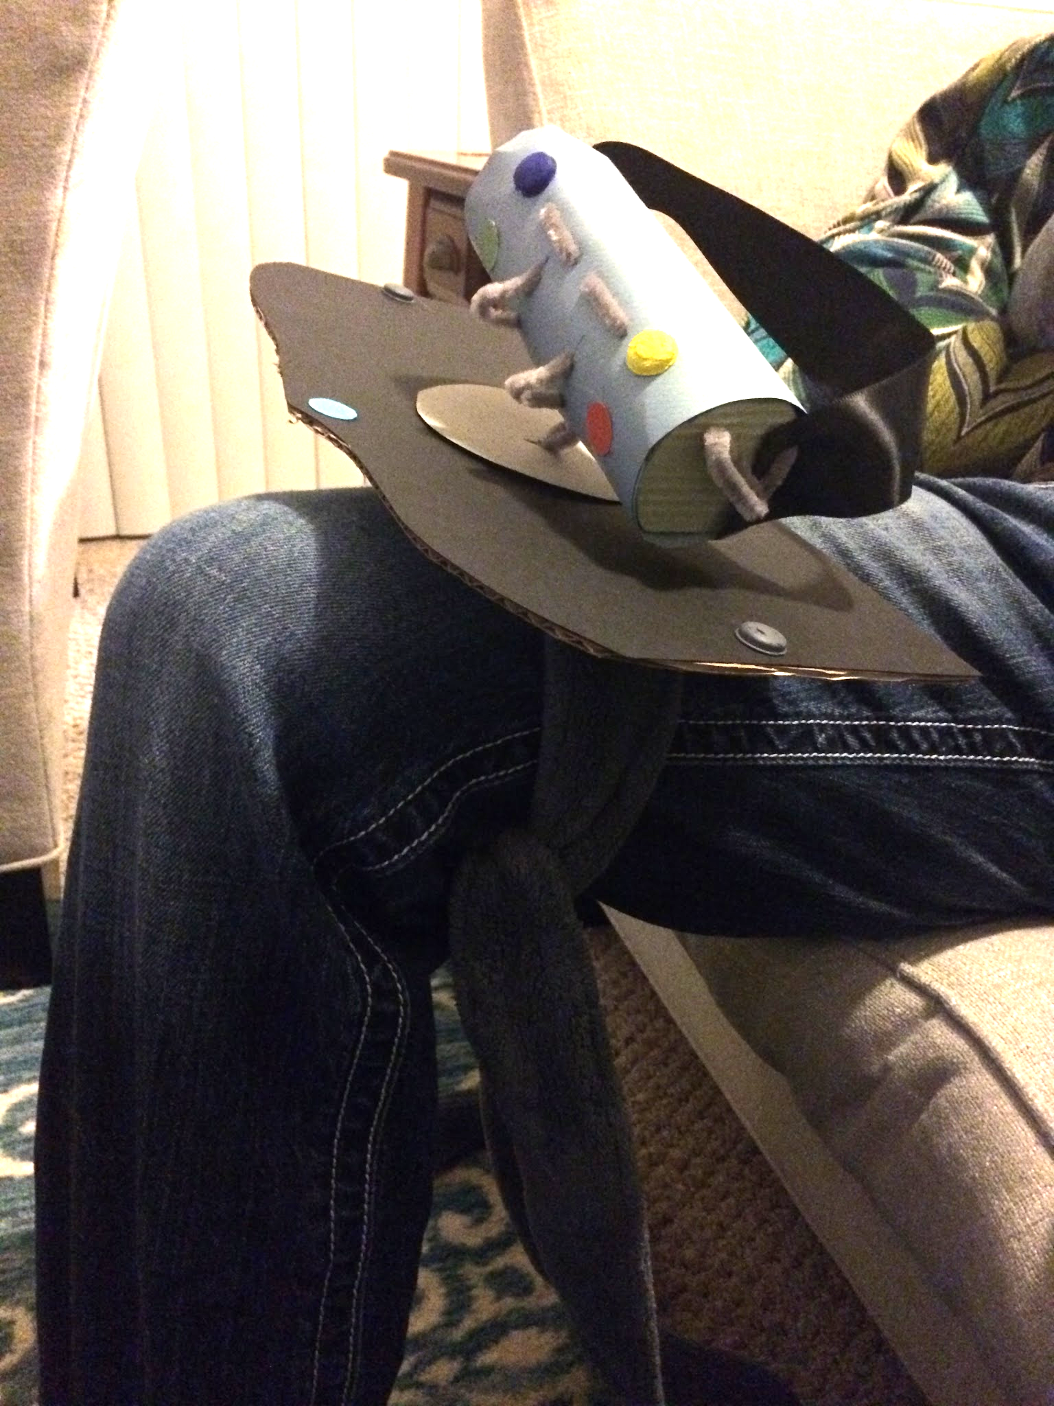
Play Test Session #1 - Call of Duty Modern Warfare
Testing Time: 30 Minutes
The playtester placed the controller in his lap and used both the hand strap and leg strap. The tester held the prototype and interacted with it while giving directions to the player with a connected controller to simulate gameplay. After the test session, the tester answered responses to questions about the controller.

Slide 32
Play Test Session #1 - Call of Duty Modern Warfare (Cont.)
The Button Layout - The tester said the button layout makes sense and demonstrated that he used the part of his finger before the first knuckle to access the buttons on top and then his fingertips to press the bottom set. He also commented that it felt like he kept hitting the triggers when using the bumpers and had to adjust his finger angle to avoid this happening. He said this was not uncomfortable to do, but just had to reposition fingers with a slight shift of the hand. The playtester explained that he did not place his fingertips in between the horizontal space of the two rows of buttons on the controller for resting, but rested them toward the bottom of the controller.

Slide 33
Play Test Session #1 - Call of Duty Modern Warfare (Cont.)
Unintended Consequence of Button Setup - Though the designers did not intend this, the tester also stated that the he used his pinky fingers to reach the green sensor button and blue button. The play tester said that it would be easier to use his pinky to access them rather than the ring finger. Additionally, it seems that the tester found it easier to rest his pinky on that button. When asked if it was uncomfortable to use the pinky (as it is not typically used for controller layouts), the playtester said he didn’t mind it.

Slide 34
Play Test Session #1 - Call of Duty Modern Warfare (Cont.)
The Sensors - The playtester said he tried not to touch the sensors the whole time, but his fingers tended to rest on them.
Wrist Movement - What he liked about the controller was the wrist movement and that finger position did not change much, which felt natural because of how it worked in conjunction with the in-game movement and the camera.
Strap Comments - The tester commented during gameplay that he liked the hand strap guided the position of his hand over the controller. After gameplay, he stated that liked both the leg and hand strap because it provided stability to the controller while he was playing.

Slide 35
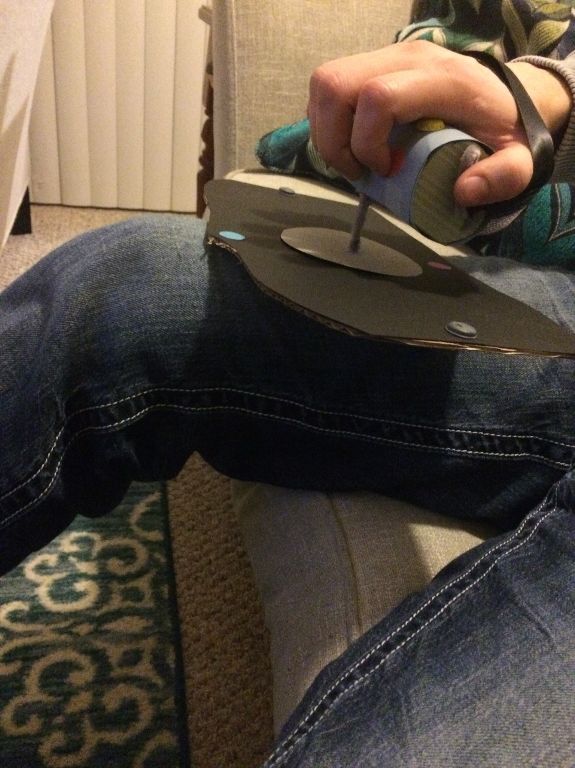
Play Test Session #2 - Never Alone
Testing Time: 30 Minutes
The playtester placed the controller in his lap and used the hand strap, but not the leg strap. The tester held the prototype and interacted with the controller while giving directions to the player with a connected controller to simulate gameplay. After the test session, the tester answered responses to questions about the controller.

Slide 36
Play Test Session #2 - Never Alone (Cont.)
Handle - The tester stated that he thought the handle would work well with the Bola mechanic in the game.
Having no leg strap - The controller was falling off and unbalanced in his lap without the leg strap to secure it.
Controller - After gameplay, he stated that felt the controller was not fully utilized for that type of gameplay and not very interactive. He felt it was not as much fun to use the controller during this experience.

Slide 37
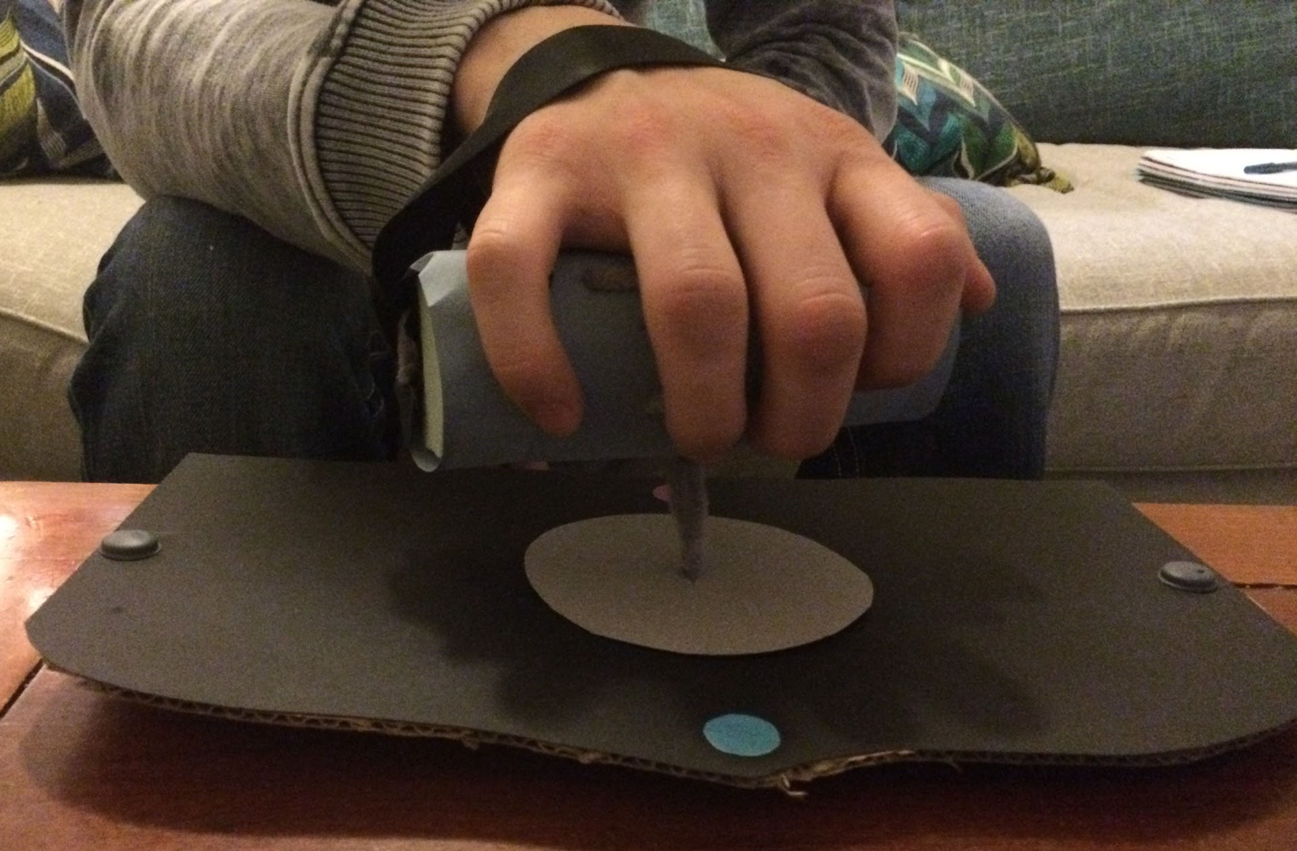
Play Test Session #3 - Halo Wars
Testing Time: 30 Minutes
The playtester placed the controller in his lap and used the hand strap, but not the leg strap; the leg strap was removed from the prototype. The tester placed the prototype on a table and interacted with the controller while giving directions to the player with a connected controller to simulate gameplay. After the test session, the tester answered responses to questions about the controller.

Slide 38
Play Test Session #3 - Halo Wars (Cont.)
Triggers - The player found himself hitting the triggers more because of the faster button interaction needed to play the game.
Button Layout - The tester said that his fingers were tired. His pinky felt a bit sore and tired at the end of this playtest. He insisted, however, that he did not want shift to those buttons using the ring finger because it did not feel natural.
Placing the controller on the table - The table provided the controller with extra stability, especially with the fast button interaction that the gameplay required.

Slide 39
Tester Final Thoughts
Size - The player said his hand felt “slightly stretched” on the controller and did not think that someone with smaller hands would easily be able to interact with it.
Aesthetics - The playtester liked the colors on the controller and felt that the differing colors gave him an easy reference to memorize the button layout with.
The Base Stability - The player felt the controller had the most stability when placing the controller on the table. He felt that he would take advantage of the removable leg strap for different genres. The tester gave the example that he would use the strap when playing RPGs and liked it for Call of Duty, but that the tabletop placement worked well for RTS games and liked how it worked for Halo Wars.

Slide 40
Tester Final Thoughts (Cont.)
Base Size - The player commented that if were to place it on his lap without the leg strap that the base would have to either be bigger so that it covered the whole lap or smaller for easy placement on his leg. He had a hard time balancing the base on his leg without the leg strap.
Spacing between Buttons - He admitted that he was initially skeptical about the vertical spacing between the buttons, but found that he used that space to navigate controls and rest. Though, he added that he would move them slightly closer together still.
Sensor Buttons - The player said that he thought the idea of the sensor buttons were cool, but felt that he would accidentally press them and preferred they were buttons.

Slide 41
Tester Final Thoughts (Cont.)
D Pad controls - He commented that he wished we added a way to translate D Pad controls to the controller to fully be able to use the Call of Duty mechanics (2 missing).
Using the Controller - The player felt that if he had to use this controller he would be able to easily adjust to the layout of it and play his preferred games with it.
Favorite Game of the Three Tested to Use the Controller With - Call of Duty Modern Warfare
Most Challenging Game of the Three Tested to Use the Controller With - Halo Wars; it felt it would be more challenging to use the controller with RTS games.

Slide 42
Post Mortem - What Happened Correctly
The teams desired vision was accurately represented in the concept artwork, 3D modeling, and the prototype.
All members of the team were able to incorporate a feature from their original design into the final product.
Team members were able to come together regardless of scheduling conflicts to meet the milestone deadlines.
Team members worked effortless together to bring the design to life.
When changes were required to be made, all members easily and successfully adapted to them.

Slide 43
Post Mortem - What Happened Incorrectly
Original design was very similar to an image from the Week Two lecture and required a major rehaul.
Our designed had changed so much and went through so many different iterations from the original version that it was difficult for members to keep track of the current version of our design, which sometimes resulted in confusion.
Because of the design update, our dimensions were off and the prototype was unproportional. This taught us the importance of being specific with our design choices.
Missed a key feature of today’s common controllers (the D Pad) resulting in an incomplete control mapping for some genres.

Slide 44
Post Mortem - What We Would do Differently
After reviewing the playtest notes, we realize that adding a D-pad to the controller would have been wise, especially when so many modern games make use of the D-pad to perform vital secondary actions.
Define a more concrete design earlier on and set a deadline for changes to the primary design. This would have kept the team from altering the core of the design at a late time and causing much iteration of the design to occur.
Obtain outside perspective from an expert gamer early on in the design phase to determine if the features are going in the desired direction.
Assembly a prototype earlier on to make sure that the functionality of the design is applicable to the desired audience.

Slide 45
References
Accessible. (2015). Retrieved from Merriam-Webster: http://www.merriam-webster.com/dictionary/accessibley
Bluetooth. (2015). Funk & Wagnalls New World Encyclopedia, 1p. 1. Retrieved from EBSCOhost at http://search.ebscohost.com.oclc.fullsail.edu:81/login.aspx?direct=true&db=funk&AN=BL122275&site=ehost-live
Bryant, C. (2003). THE HIDDEN LIFE OF batteries. Sierra, 88(6), 26-27. Retrieved from http://search.ebscohost.com.oclc.fullsail.edu:81/login.aspx?direct=true&db=a9h&AN=11205903&site=ehost-live
Crisco, J. J., Schwartz, J. B., Wilcox, B., Costa, L., & Kerman, K. (2015). Design and Kinematic Evaluation of a Novel Joint-Specific Play Controller: Application for Wrist and Forearm Therapy. Physical Therapy, 95(7), 1061-1066. doi:10.2522/ptj.20140344. Retrieved from http://search.ebscohost.com.oclc.fullsail.edu:81/login.aspx?direct=true&db=a9h&AN=103674243&site=ehost-live
McGloin, R., Farrar, K., & Krcmar, M. (2013). Video Games, Immersion, and Cognitive Aggression: Does the Controller Matter?. Media Psychology, 16(1), 65-87. doi:10.1080/15213269.2012.752428. Retrieved from http://search.ebscohost.com.oclc.fullsail.edu:81/login.aspx?direct=true&db=ufh&AN=85587943&site=ehost-live

Slide 46
References (Cont.)
Nintendo (2011, April 19). Patent US7927216 - Video game system with wireless modular handheld controller. Retrieved December 7, 2015, from https://www.google.com/patents/US7927216
PR, N. (2014, October 23). SomaTone Interactive Forges New Collaboration with Immersion Corporation to Bring Immersive Tactile Effects to the Mobile Video Games Industry. PR Newswire US. Retrieved from http://search.ebscohost.com.oclc.fullsail.edu:81/login.aspx?direct=true&db=bwh&AN=201410230715PR.NEWS.USPR.SF45666&site=ehost-live
Shafer, D. M., Carbonara, C. P., & Popova, L. (2014). Controller Required? The Impact of Natural Mapping on Interactivity, Realism, Presence, and Enjoyment in Motion-Based Video Games. Presence: Teleoperators & Virtual Environments, 23(3), 267-286. doi:10.1162/PRES_a_00193. Retrieved from http://search.ebscohost.com.oclc.fullsail.edu:81/login.aspx?direct=true&db=a9h&AN=98972982&site=ehost-live
Wagner Jr, J. R. (1985). U.S. Patent No. 4,494,754. Washington, DC: U.S. Patent and Trademark Office. Retrieved from Google Scholar at https://www.google.com/patents/US4494754

